Slide 1
“Look Into Wood Buffalo” Community Wellbeing Survey
Lunch and Learn Presentation
Monday, May 5, 2014
Hosted by:
Notes:
Thank you for coming to the lunch and learn.
My name is Ifeatu Efu and I am the Project Manager for Social Prosperity Wood Buffalo.
For those of you who don’t know us, Social Prosperity Wood Buffalo is a collaborative social change process to build and sustain innovation and social change in the regional municipality of Wood Buffalo. It grew out of the Suncor Energy Foundation’s vision to improve quality of life by building the capacity of the social benefit sector. It’s a partnership between stakeholders in Wood Buffalo, the Suncor Energy Foundation and the University of Waterloo.
FuseSocial is a newly created organization that grew from the merger of three social benefit organizations: Leadership Wood Buffalo, Nonprofit Sector Link and Volunteer Wood Buffalo. It’s mission is, “Enabling social innovation for the Wood Buffalo community.” We’re working together on the “Look into Wood Buffalo” Community Wellbeing Survey working group which includes most of the partners who are listed on this slide.
Today, we’re going to do a 30-minute presentation about the community wellbeing survey and there will be time for questions and answers after that.

Slide 2
“LOOK INTO WOOD BUFFALO” COMMUNITY WELLBEING SURVEY
How are you doing?
Notes:
Ask participants to do an exercise. (Note: A similar exercise was done at Convergence, but it’s a great way to get them to think started!)
Take out a piece of paper and draw a circle. The middle circle is a “10” and the outside circle is a “1”. Get them to divide the circle into 8 categories:
Time Use
Democratic Engagement
Education
Environment
Health
Leisure and Culture
Living Standards
Community Vitality
Ask them to rank each one from 1 (being low) to 10 (being high)
Then ask everyone to share their results with each other. Are there any trends? Discuss together as a larger group.

Slide 3
“LOOK INTO WOOD BUFFALO” COMMUNITY WELLBEING SURVEY
What is wellbeing?
Notes:
There are many definitions of wellbeing. The Canadian Index of Wellbeing has adopted the following as its working definition:
The presence of the highest possible quality of life in its full breadth of expression focused on but not necessarily exclusive to: good living standards, robust health, a sustainable environment, vital communities, an educated populace, balanced time use, high levels of democratic participation, and access to and participation in leisure and culture.

Slide 4
“LOOK INTO WOOD BUFFALO” COMMUNITY WELLBEING SURVEY
Notes:
In January 2013, Social Prosperity Wood Buffalo began researching shared measurement systems which eventually led to a partnership with The Canadian Index of Wellbeing (CIW), an award-winning success story that takes a holistic view of wellbeing.
The CIW framework includes eight domains of wellbeing: community vitality, democratic engagement, education, environment, environment, healthy populations, leisure and culture, living standards, time use.
The CIW has created a community (also known as subjective) wellbeing survey that assesses the 8 domains of wellbeing at the individual level.
This provides a more in-depth understanding of your perceptions of services, activities, and your own lifestyle that either contribute to or detract from overall quality of life.

Slide 5
“LOOK INTO WOOD BUFFALO” COMMUNITY WELLBEING SURVEY
IT’S ABOUT OUR WELLBEING,
NOT JUST ABOUT OUR ECONOMY!
Notes:
The purpose of the survey is to gather information about our quality of life.
It’s a community check-in to see how you’re doing.
Are you living a happy, active and healthy life?
What are some of the things that are getting in the way of your wellbeing?
We want to check in with you and your neighbours so that we can address these roadblocks and improve the quality of life for all residents.

Slide 6
Notes:
Have you seen this poster in newspapers and heard about the “Look into Wood Buffalo” Community Wellbeing survey! We’ve been promoting the survey all over the place because we want as many residents as possible to fill it out. But only those who receive an invitation in the mail can participate.

Slide 7
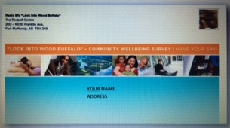
“Look Into Wood Buffalo” Community Wellbeing Survey
Notes:
This week, about 6,000 randomly selected households will receive an envelope like this one in the mail. Please don’t toss it in the recycling box! We want you to open it and take part in the online survey. This is your opportunity to have your say. Each household will receive a unique code that you’ll need to access the online survey.
Your feedback is very important, so please, if your household is chosen, please fill it out!

Slide 8
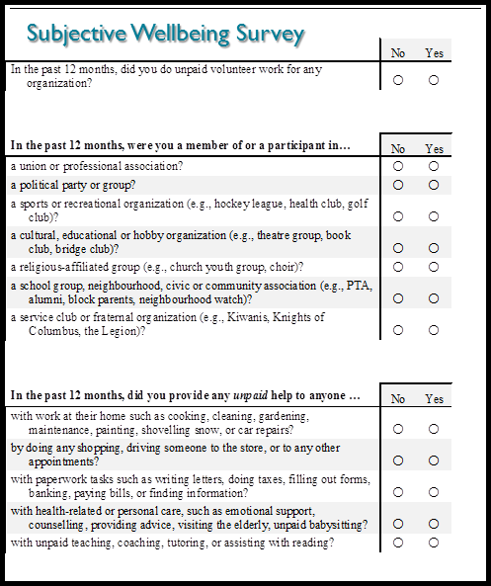
“LOOK INTO WOOD BUFFALO” COMMUNITY WELLBEING SURVEY
Notes:
The survey asks questions related to each of the eight domains of wellbeing. For example, it asks, “How would you rate the overall accessibility of the health care services in our community?” And, “Do you feel you have adequate time to do the things that are important to you?” These are questions that help us understand what is contributing or detracting from your quality of life.
Because there are many factors that contribute to your quality of life, the survey is fairly lengthy. Don’t let that stop you from doing it! We even have some great prizes for people who complete it! It should take about 30 minutes, so why not get yourself a cup of tea or coffee before you begin?
While it’s true that some people feel that they are over-surveyed, surveys continue to be a primary tool for gathering feedback.
If your household is selected, we need someone 18 years or older to fill out the survey. Your feedback is really important because only 25% of households are being sampled. We need as many people to respond as possible so that we have a broad and deep understanding of wellbeing in our community. From there we will be in a great place to develop plans that address the issues! How can we design good plans if we don’t really understand the issues?
The results from the survey will help us understand where people are struggling. From there, we as a multi-sectoral group of organizations can collaborate to address the issues. We want to be in a position to know how we can support the priority strategy of improving the quality of life for all residents now and in the future. This survey is going to help us understand how to do that.

Slide 9
“LOOK INTO WOOD BUFFALO” COMMUNITY WELLBEING SURVEY
Notes:
Depending where you live, there are great prizes! The prizes for Fort McMurray residents include a family membership to MacDonald Island Park, a weekend get-away for two to explore the region and a fabulous arts package. Once you complete the survey, you’re invited to enter your name in the draw. A separate system is being used for the draw to protect your anonymity.

Slide 10
“LOOK INTO WOOD BUFFALO” COMMUNITY WELLBEING SURVEY
WHO WILL USE THE INFORMATION? HOW?
WHO HOW IT WILL IMPROVE QUALITY OF LIFE
Decision-makers Prioritize strategic plans
Funders Allocate resources to areas of highest need
Social Benefit Orgs Align strategies to address issues
Citizens Advocate for social change
Notes:
The results can be used for a variety of purposes. For example, decision-makers can use it to prioritize activities; funders can use it to allocate resources to areas of highest need; social benefit organizations can use it to inform strategic plans; citizens can use it to advocate for positive social change.

Slide 11
“LOOK INTO WOOD BUFFALO” COMMUNITY WELLBEING SURVEY
TIMELINE:
Week of May 3rd: Surveys mailed to households
May 3 – June 20: Survey is live
October 1st: Report-back presentation
October 2nd, 3rd: Analysis of survey results
December 20th: Final report available online

Slide 12
“LOOK INTO WOOD BUFFALO” COMMUNITY WELLBEING SURVEY
QUESTIONS?
Notes:
Ifeatu: Please review the common questions and answers in the project charter!

Slide 13
“LOOK INTO WOOD BUFFALO” COMMUNITY WELLBEING SURVEY
For More Information
Ifeatu Efu, Project Manager,
Social Prosperity Wood Buffalo
Ifeatu@socialprosperity.ca
Cell: (587) 646-7238
Notes:
Thank you for having me. Please email me or give me a call if you have any questions.

