Slide 1
Demystifying Canada’s New Anti-Spam Law for Charities and Non-Profits Capacity Waterloo Region Seminar
Thursday, June 26, 2014

Slide 2
overview
▪ CASL Application
▪ Key Provisions
▪ Issues for Charities and Nonprofits
▪ CEM Content - Templates
▪ Consent
▪ Exemptions
▪ Transition Period
▪ Compliance Checklist
▪ Tools to Consider
▪ Key Information References

Slide 3
CASL Application
Applies to all “commercial electronic messages” (CEMs)
by any person within Canada;
by any person outside of Canada to a person within Canada
Applies to all organizations and all electronic messages sent by them that have a commercial purpose
CEMs include emails, text messages, social media and website interactions, other electronic communications sent for the purpose of a commercial activity
Applies to social media if message is directed to a specific person or persons
Does not apply to tweets and postings (e.g. Facebook) if not directed to a person

Slide 4
What is a Commercial Electronic Message (cem)?
An electronic message that, having regard to its content, or its links, or the contact information provided, would reasonably be determined to have as a purpose encouraging participation in a commercial activity
Commercial activity is defined to include any commercial transaction whether or not for profit
Will apply to many activities carried on by charities/not for profits/social benefit organizations (e.g. sale of tickets, services, merchandise, memberships)

Slide 5
CASL Overview – Key Provisions
CEM content requirements:
Sender contact information;
Unsubscribe mechanism
Consent - is required and must be express (opt-in), or fall within a defined “implied consent” category
Exceptions, exemptions

Slide 6
Issues for Charities, Non-Profits and Social benefit organizations
Is your organization a registered charity?
Do you send CEMs?
Is at least one of the purposes of the message promotion of a commercial activity (e.g. sale of tickets, merchandise)?
Is the main purpose fundraising? CEMs that are sent by charities with the main purpose of fundraising are excluded from both the consent and content requirements
Do your CEMs qualify for implied consent? - applies to (defined) existing business and existing non-business relationships
Do your CEMs qualify under a specific exception?

Slide 7
CEM Content ─ Sender Contact Information
All CEMs must clearly and prominently disclose:
Identity of sender
Any carrying-on-business names
Contact information for sender:
mailing address, and
one of:
telephone number with active response voicemail
email address
web address
If “not practicable” to include in CEM, may provide the info on a web page via a readily accessible, no-cost link within the CEM

Slide 8
CEM Content – Unsubscribe Mechanism
Must be easy to see to enable recipient to request removal from list and be able to be “readily performed”
Using same or, if that is not practical, other equivalent electronic media
Must provide electronic address or a link to a web page, to which unsubscribe message may be sent
Address/web page must be valid for 60 days
Sender must comply within 10 business days

Slide 9
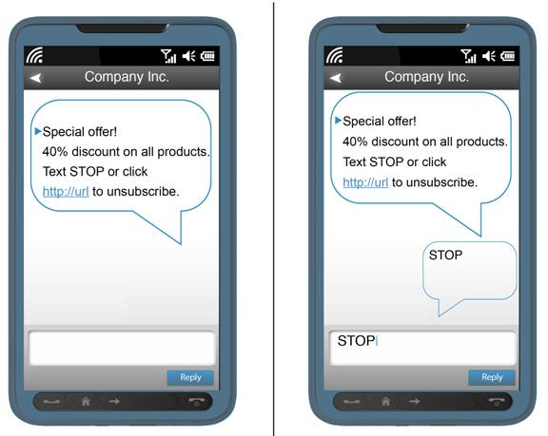
Unsubscribe Mechanism - technological neutrality Example
:

Slide 10
Example – sender contact information and unsubscribe
You are receiving this email because you have subscribed for our monthly e-newsletter. If you no longer wish to receive these emails, click here, or Contact Us.
Contact us at: Ontario Nonprofit Network
720 Bathurst Street, Ste. 405
416-642-5786
email: cathy@the onn.ca

Slide 11
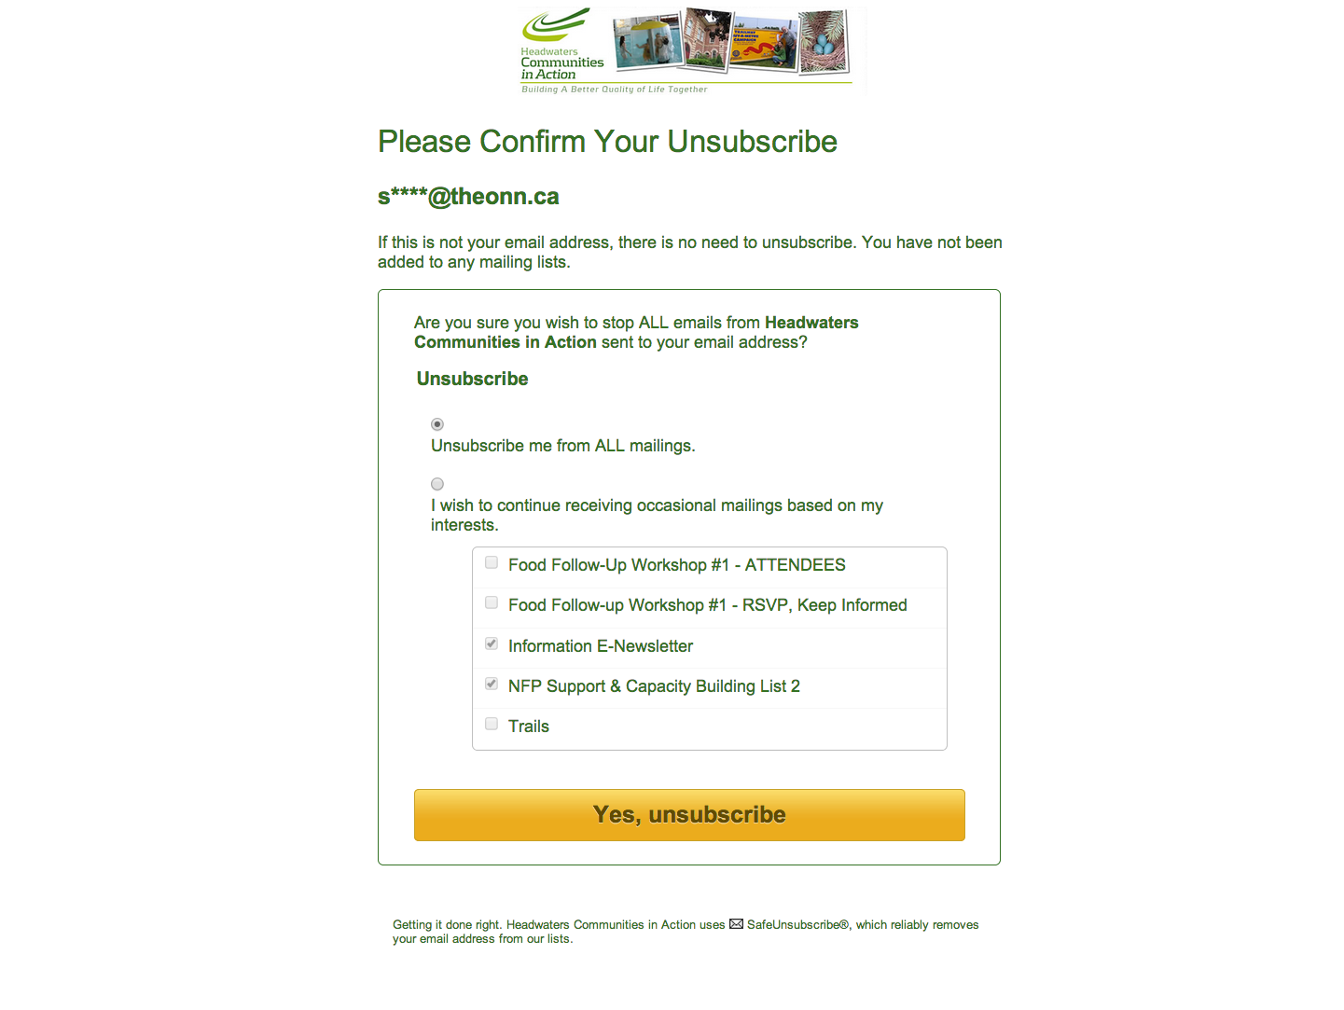

Slide 12
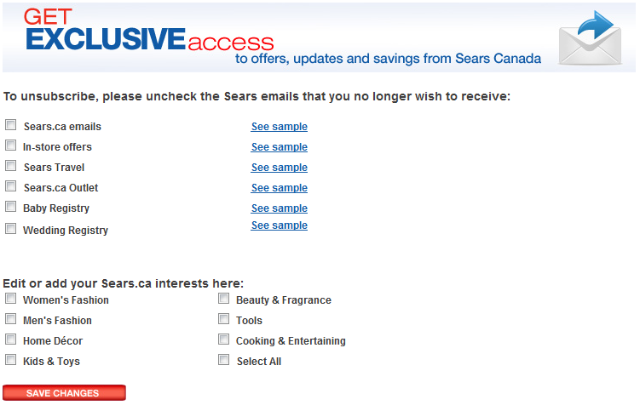
unsubscribe with options - Example

Slide 13
CEM footer
Information to include:
State why/how the recipient is receiving the message
Sender by legal name and brand name (the name by which sender carries on business)
Sender mailing address and one of an email address, web address or telephone number
Unsubscribe mechanism
Other considerations:
Links to sender’s online privacy policy and website legal terms
Trademark legend
Copyright notice

Slide 14
Cem footer example
You are receiving this email because [you previously agreed to receive information about the ABC Company ® rewards program and other information that may interest you].
To ensure you receive future emails from us, please add abccompany@abc.com to your address book.
To unsubscribe from future email communication, please click here.
ABC Company Inc., 100 Yonge Street, Suite 100, Toronto, ON
www.abccompany.com

Slide 15
Express Consent
“Express consent” is not defined in CASL, but must be a positive (i.e. opt-in) act whereby a person consents to receive CEMs for a stated purpose
Existing consents continue to be valid
May be either oral or in writing.
Best practice: if it can be verified by an independent third party or an audio recording of consent is maintained
No bundling (CRTC comment): request for consent must not be subsumed in, or bundled with other general provisions– not clear whether/in what circumstances request for consent can be included in another document (e.g. an application form) without an opt-out readily available – i.e. as part of the application, you are consenting to receiving emails

Slide 16
Express Consent (cont.)
Only need to obtain consent once and, unless revoked, the consent remains valid
No legal requirement to provide receipt of consent (although it can be considered a best practice – provides evidence that consent was received and reconfirms recipient’s intent)
Requests for consent made prior to the CASL in-force date do not need to comply with the Act’s specific form and content requirements but would still need to represent “express consent”

Slide 17
Requests for Consent
Note: a request for consent made after July 1 is a CEM
The request must include:
purpose(s)
identify requester, any principal and that relationship (e.g. client and email provider)
any other business names
contact information (street address and one of: telephone number, email address, web address)
that you can can withdraw consent

Slide 18
Request for Consent Template
□ Send me messages about ABC Company events, news, offers, surveys, promotions and information about products and services.
I may withdraw my consent at any time by unsubscribing to any such message.
ABC Company Inc., 100 Yonge Street, Suite 100, Toronto, ON M2J 2J5 www.abccompany.com

Slide 19
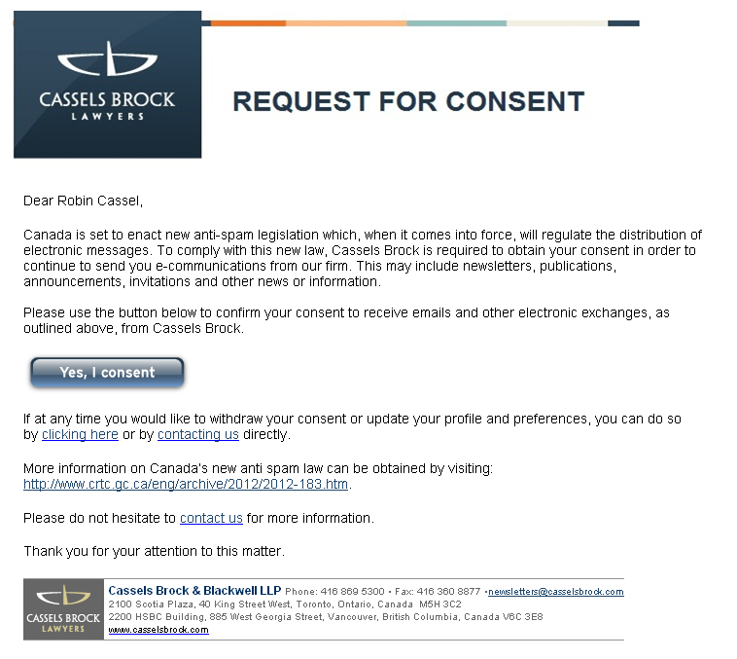
Request for consent - example

Slide 20
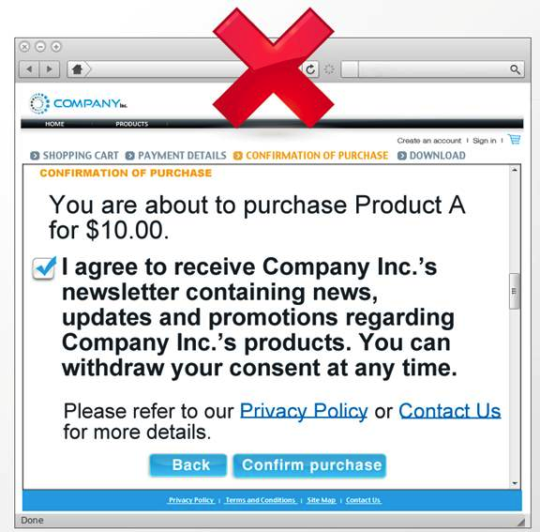
CRTC Guidelines - Express Consent
No pre-checked boxes
CRTC Comment: pre-checked boxes not acceptable even if person must click icon to accept/submit

Slide 21
Implied Consent
Specifically defined (i.e. is not open-ended)
Exists only: If sender and recipient have an existing business relationship or existing non-business relationship; or recipient has published conspicuously the email address to which a message may be sent or has disclosed the address to the sender, without including that they do not want to receive emails and the message is relevant to the recipient’s role, function or duties;
“Existing business relationship” and “existing non-business relationship” are (exhaustively) defined terms – essentially, any relationship not more than 2 years old, or a (business) inquiry within the last 6 months

Slide 22
implied consent - Existing Business Relationship
Purchase or lease of a product or service, or land, within the previous 2 years
Written contract between sender and recipient within the previous 2 years (includes event registration, purchase of tickets)
Inquiry or application by recipient within the previous 6 months

Slide 23
Implied consent - Existing Non-Business Relationship
Donation or gift made by the recipient within the previous 2 years to a registered charity, political party or candidate
Volunteer work or attendance at a meeting of a registered charity, political party or candidate by the recipient within the previous 2 years
Membership in a club, association or voluntary organization (defined: any non-profit purpose)

Slide 24
Exemptions - All CEM Requirements
Consent, content and unsubscribe requirements do not apply to CEMs:
sent within family or personal relationships
that make an inquiry or application, or
in other prescribed categories

Slide 25
Exemptions – All CEM Requirements (cont.)
Charities – CEMs that have as their primary purpose fundraising
Entity to entity – CEMs within an organization or between organizations that have a “relationship” – by and to an employee or a “representative” of the organization concerning its “activities”
Responses to inquiries, complaints
Other specific (e.g. sent pursuant to legal obligations, sent on messaging services)

Slide 26
Exemptions - Consent Requirements
Consent is not required if:
Providing a quote or estimate requested by the recipient;
Confirming a commercial transaction among the parties;
Providing warranty, recall, safety or security information;
Notifying of factual information relating to the ongoing use or purchase of a product, good or service under an established relationship;
Providing information relating to an employment relationship, including a benefit plan;
Delivering a product, goods or service including product updates/upgrades; or
Following up on a referral

Slide 27
Transition Period
Extends the time periods for all existing business and non-business relationships to 3 years from the CASL in-force date if on that date there exists such a relationship, without regard to the time period otherwise applicable, and the relationship includes CEMs
Means that any relationship that includes CEMs and exists now or at any time in the past will qualify – however, onus is on the sender to prove
Enables senders to continue to seek express consents for the next 3 years with implied consent, if any of the otherwise defined relationships exist or have existed

Slide 28
Compliance Checklist
Use internal survey/questionnaire tool to gather information on existing databases
Conduct an inventory of email contacts – categorized by:
Main purposes of email communications
Existing donor/volunteer/customer/user relationships
Express consent
Determine compliance strategy – whether to rely on exceptions/implied consents vs. express consent
If to rely on exceptions, etc., upgrade databases by CASL categories
If will seek express consent, develop strategies for capturing (e.g. email response, website sign up, applications, agreements, email policies) and initiate email opt-in consent program immediately (i.e. prior to Act coming into force)
Develop CEM template/footer
Develop consent request template
Develop CASL compliance procedures, policies, and controls including for third party service providers
Conduct training

Slide 29
Tools to consider
These are some tools available to manage subscribers, members and do email marketing (eblasts/ e-bulletins). We are providing this list as a resource, but please note that we do not endorse any of these tools.
Wild Apricot- membership management, including eblasts: http://www.wildapricot.com/
Constant Contact- event, email and social marketing: http://www.constantcontact.com/index.jsp
Mailchimp- email marketing: http://mailchimp.com/
Sumac: nonprofit data management including fundraising, membership, events, email marketing: http://sumac.com/

Slide 30
CASL – key Information references
CRTC Regulations(form and content requirements)
Industry Canada Regulations (exceptions, exemptions)
CRTC Compliance and Enforcement Information Bulletins (October 2012; June 2014)
Industry Canada Regulatory Impact Analysis Statement
Industry Canada FAQs
Industry Canada website: http://fightspam.gc.ca
CRTC Revised FAQs (June 23, 2014)
CRTC website: http://www.crtc.gc.ca/eng/casl-lcap.htm
David Young Law Compliance Bulletins (April 2014)
David Young Law Anti-Spam Toolkit: http://davidyounglaw.ca/anti-spam/

Slide 31
questions

Slide 32
discussion

Slide 33
For Further Information please contact:
David Young
David Young Law
T: 416.968.6286
M: 416.318.5521
david@davidyounglaw.ca
Web: www.davidyounglaw.ca
THANK YOU

